Slide 1
Efficient Probabilistic K-core Computation on Uncertain Graphs
You Peng, Ying Zhang, Wenjie Zhang, Xuemin Lin, Lu Qin
University of New South Wales, University of Technology Sydney

Slide 2
Outline
Introduction
Problem Definition
Proposed method
Experiment
Conclusion

Slide 3

K-Core
G(V,E): undirected graph
K-core: maximal subgraphs where every node’s degree in this subgraph $≥$ k
2-core

Slide 4

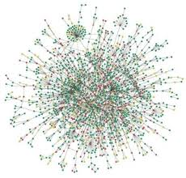
Uncertain Graphs
Many real life networks are associated with uncertainty:
  Data collection process
  Privacy-preserving reasons
  Natural applications
    Biological networks, protein-interaction networks
    Social networks

Slide 5

Probabilistic k-core
Probabilistic k-core : Dealing with edges with probabilities
Various versions for extending k-core to uncertain graphs
  Expected k-core model
  $\left(k,η\right)$-core KDD 2014
  $\left(k,θ\right)$-core this paper

Slide 6



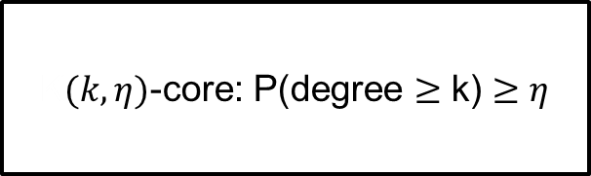
Probabilistic k-core
$\left(k,η\right)$-core KDD 2014
Maximal subgraph
Kk-core: degree $≥$ k
K$(k,η)$-core: P(degree $≥$ k) $≥η$
$$P(degree≤3)$$

Slide 7
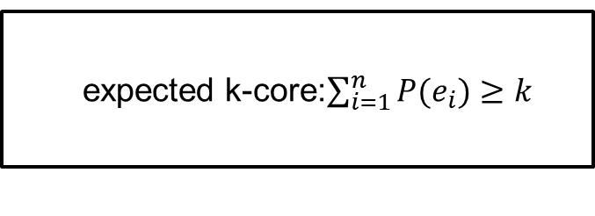

Probabilistic k-core
Expected k-core model
Maximal subgraph
Sum all neighbor edges’ probability
Kk-core: degree $≥$ k
Kexpected k-core:$\sum_{i=1}^{n}{P(e_{i})}≥k$

Slide 8
Before introduce our model, we will introduce possible world semantics

Slide 9

Possible World Semantics
${P(G}_{1})$: $P\left(b,c\right)∗P\left(c,d\right)∗\left(1−P\left(b,d\right)\right)=0.05$
${P(G}_{2})$: $P\left(b,c\right)∗(1−P\left(c,d\right))∗P(b,d)=0.05$
$2^{3}$ = 8 possible worlds in total
Two example possible worlds

Slide 10
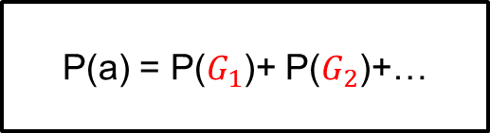

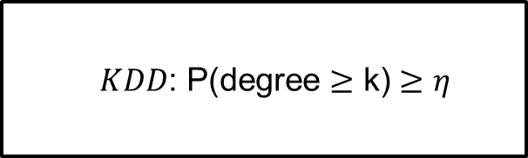
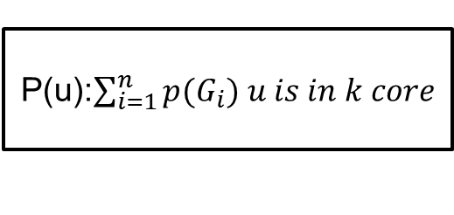
Probabilistic k-core
$\left(k,θ\right)$-core this paper
P(u): probability u in k-core
P(a) = P($G_{1}$)+ P($G_{2}$)+…
K$KDD$: P(degree $≥$ k) $≥η$
P(u):$\sum_{i=1}^{n}{{p(G}_{i}) u is in k core}$

Slide 11
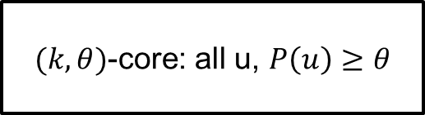

Probabilistic k-core
$\left(k,θ\right)$-core this paper
K-core memberships
$(k,θ)$-core: all u, $P\left(u\right)≥θ$
K$KDD$: P(degree $≥$ k) $≥η$
P(u):$\sum_{i=1}^{n}{{p(G}_{i}) u is in k core}$

Slide 12


Applications
Vital vertices set detection
Influential social communities detection
Social network engagement

Slide 13
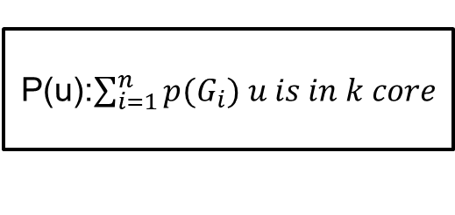

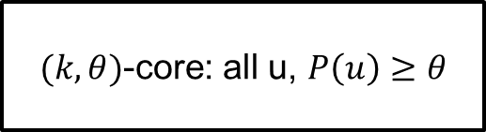
Challenges
How to compute P(u)?
Enumerate possible worlds?
$2^{m}$ possible worlds in total
NP-hardness
$(k,θ)$-core: all u, $P\left(u\right)≥θ$
P(u):$\sum_{i=1}^{n}{{p(G}_{i}) u is in k core}$

Slide 14
Monte Carlo Sampling

Slide 15

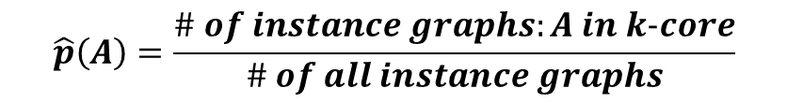
A
0.6
B
A
B
toss
Instance graph 1
(A not in 2-core)
0.5
0.4
C
C
……
A
B
Instance graph s
(A in 2-core)
$$\hat{p}\left(A\right)=\frac{\# of instance graphs:A in k−core}{\# of all instance graphs}$$
C

Slide 16

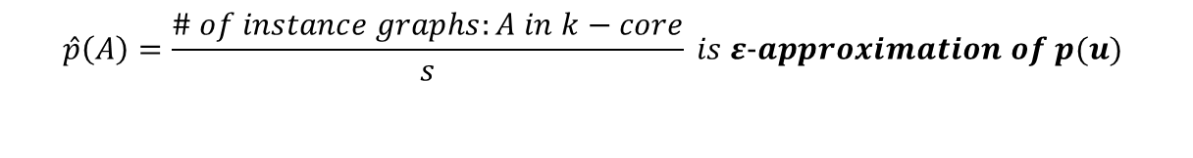
s = # of all instance graphs
$$\hat{p}\left(A\right)=\frac{\# of instance graphs:A in k−core}{s} is ε−approximation of p(u)$$
$$s≥\frac{1}{2ε^{2}}ln(\frac{2n}{δ})$$
$\left|\hat{p}\left(u\right)−p\left(u\right)\right|≤ ε with confidence 1−δ$

Slide 17
Observation 1：Deterministic k-core pruning
Prune D，E
D
E
0.6
0.6
A
0.6
B
0.5
0.4
C
K=2

Slide 18
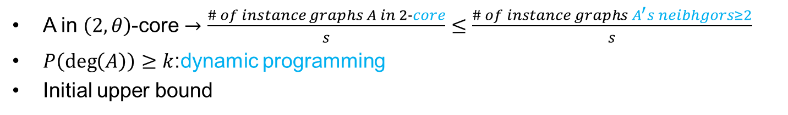
Observation 2：upper bound
A in $（2,θ）$-core $→\frac{\# of instance graphs A in 2−core}{s}≤\frac{\# of instance graphs A^{′}s neibhgors≥2}{s}$
$P\left(\deg\left(A\right)\right)≥k$:dynamic programming
Initial upper bound
A
0.6
B
A
B
toss
Instance graph 1
(A not in 2-core)
0.5
0.4
C
C
……
A
B
At least 2 neighbors
Instance graph s
(A in 2-core)
C

Slide 19
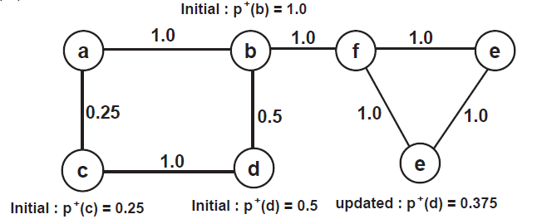

Observation 2 : tighter upper bound
Get tighter bound?
Markov Inequality
$p\left(u\right)≤ \sum_{i=1}^{h}{\frac{\min{(p(e\left(u,v_{i}\right),p^{+}(v_{i}))}}{k}}$
Example

Slide 20
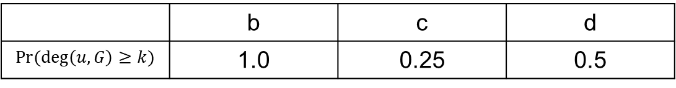
Observation 2 : tighter upper bound
Example:
 | b | c | d
 | 1.0 | 0.25 | 0.5

Slide 21

Observation 2 : tighter upper bound
Example:
$p\left(d\right)≤\frac{\min\left(p\left(c,d\right),p^{+}\left(c\right)\right)+\min\left(p\left(b,d\right),p^{+}\left(b\right)\right)}{2}=\frac{\min\left(1,0.25\right)+\min\left(1,0.5\right)}{2}=0.375$

Slide 22
Reducing toss

Slide 23
Observation 3 : early terminate in one instance
Toss 1 miss: no need to toss 2 and 3
toss 1
A
0.6
B
toss1
A
B
0.5
0.4
0.5
toss 3
toss 2
C
0.4
toss 3
toss 2
C

Slide 24
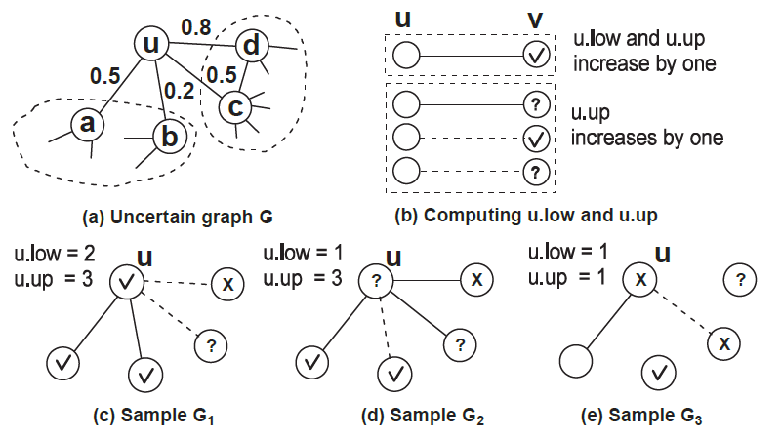

Observation 3 : early terminate in one instance
Sampling based upper/lower bounds for pruning
Three status
  √: confirmed in k-core of $G_{i}$
  X: excluded from k-core of $G_{i}$
  ?: needing further computation
K=2

Slide 25




Observation 4: early terminate in all samples
A
B
$G_{1}$(A not in 2-core)
$$\frac{\#of instance graphs A in 2 core}{s}≥θ$$
$$when sample G_{k}$$
$$no need sample G_{k_{i+1}}……G_{s}$$
C
……
A
B
A
0.6
B
$G_{k}$(A in 2-core)
toss
0.5
0.4
C
C
……
A
B
$G_{s}$(A in 2-core)
C

Slide 26

Observation 4: early terminate in all samples
$n_{1}$: current # of instance graphs u in k-core
$n_{2}$: # of not sampled instance graphs
Lower bound:${\hat{p}}^{−}\left(u\right)=\frac{n_{1}}{s}$
Upper bound:${\hat{p}}^{+}\left(u\right)=\frac{{n_{1}+n}_{2}}{s}$
Exclude u : ${\hat{p}}^{+}\left(u\right)<θ$
Include u : ${\hat{p}}^{−}\left(u\right)≥θ$

Slide 27
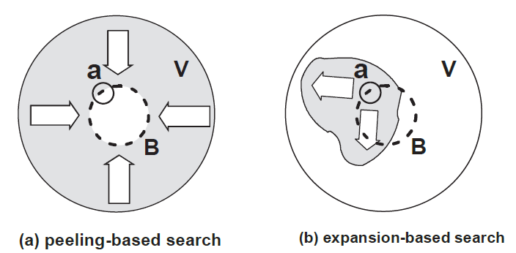
Challenge
Only one node not sure in one instance graph-> sample all edges
Only node not sure in whole sampling -> sample all instance graphs
How?
K-core membership check
Two search paradigms
nodes not sure

Slide 28
Advanced sampling algorithms
K-core membership check:
  Active update: choose an edge and sample it
  Passive update: sample an edge lead to update of neighbors’ upper and lower bound.

Slide 29
Summary
Monte Carlo sampling : approximate result with theoretical guarantee.
Basic sampling algorithm
  Pruning techniques
    Deterministic K-core based pruning
    Probabilistic Upper bound based pruning
    Sampling based upper/lower bounds for pruning
Advanced sampling algorithm
  K-core membership check
    Active update
    Passive update

Slide 30
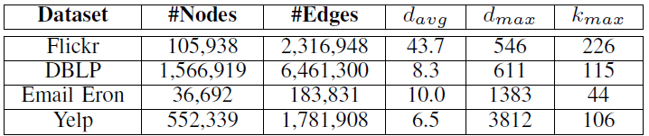

Experiments
Datasets
  Flickr: edge probability - Jaccard coefficient on interest groups
  DBLP: edge probability - an exponential function on the number of collaborations.
  Email Eron and Yelp: edge probability - random from interval[0,1].
  Default k is 15 and $θ$ is 0.7.

Slide 31
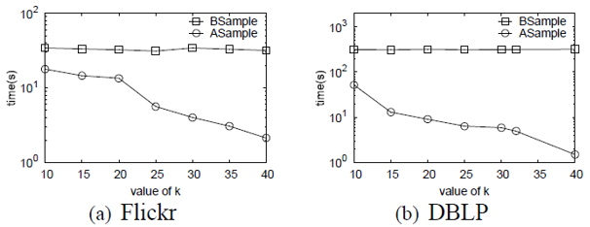
Experiments
Advanced sampling about one order faster than baseline when vary k
Bsample: Basic sampling Asampe: Advanced sampling

Slide 32
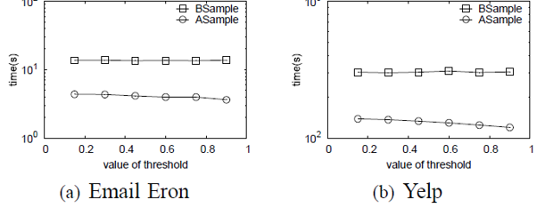

Experiments
Advanced sampling several times faster than baseline when varying $θ$
Bsample: Basic sampling Asampe: Advanced sampling

Slide 33
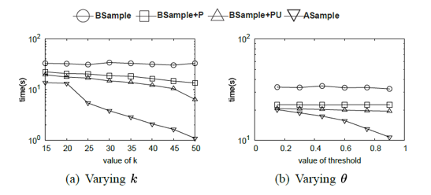
Experiments
Pruning techniques influence
  BSample : Baseline
  BSample+P: Add deterministic k-core pruning to baseline
  BSample+PU: Add upper and lower bounds to Bsample+P
  Asample: Add k-core membership check to Bsample+PU
Advanced technique improves most

Slide 34
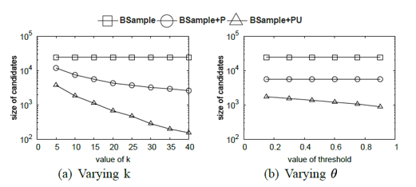
Experiments
Pruning techniques influence
  BSample : Baseline
  BSample+P: Add deterministic k-core pruning to baseline
  BSample+PU: Add upper and lower bounds to Bsample+P
P and U reduce similar candidates size

Slide 35
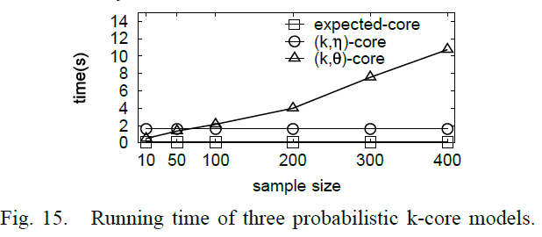
Experiments
200 samples is enough
Jaccard distance 200 and 4000 is only 0.02
Running time acceptable in practice

Slide 36
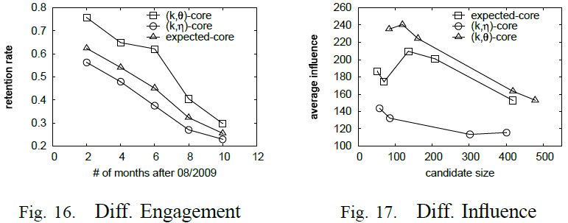
Experiments
Engagement: Brightkite. (|V|=58,228, |E|=214,078)
Influence spread: Twitter graph.(|V|=81,306, |E|=1,768,149)

Slide 37

Conclusion
A new k-core model, $\left(k,θ\right)$-core model, based on possible world semantics
A new perspective both in semantic analysis and empirical study
Propose efficient pruning rules, upper and lower bounds and k-core membership check
Proposed techniques significantly improves efficiency and effectiveness

Slide 38
Questions

